Slide 1
Introduction to Children’s Literature
Lilly Chin
MIT HSSP

Slide 2
Class Overview
Brainstorming
History of (Western) Children’s Literature
Discussion - Modern Works and Adaptations

Slide 3
What Were Your Favorite Stories Growing Up?

Slide 4
What Does Children’s Literature Mean To You?

Slide 5
What Does Childhood Mean To You?

Slide 6
Idea of Child
How Children are Treated
How Children Behave

Slide 7
Original Sin
(way back– 1800s)

Slide 8
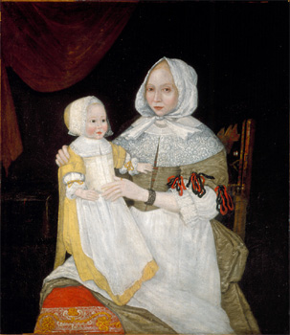
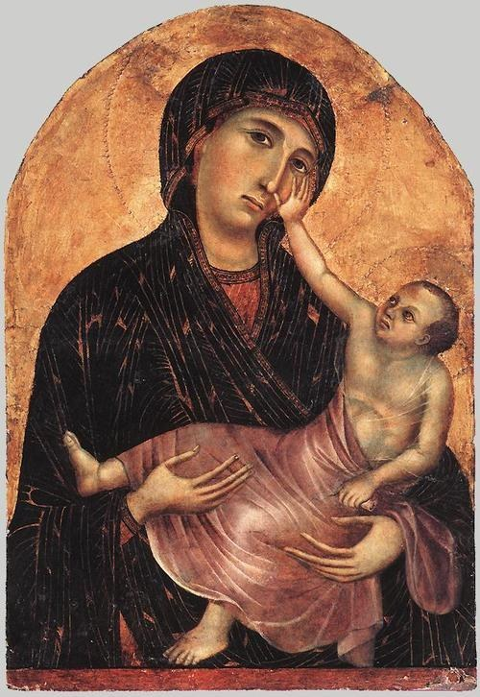
Original Sin
http://uglyrenaissancebabies.tumblr.com/

Slide 9
Original Sin
“[Children] are young vipers—and are infinitely more hateful than vipers—and are in a most miserable condition [….]”
“they are naturally very senseless and stupid”
- Jonathan Edwards

Slide 10
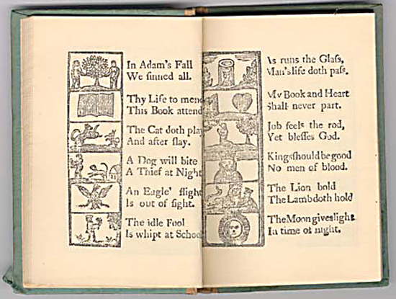
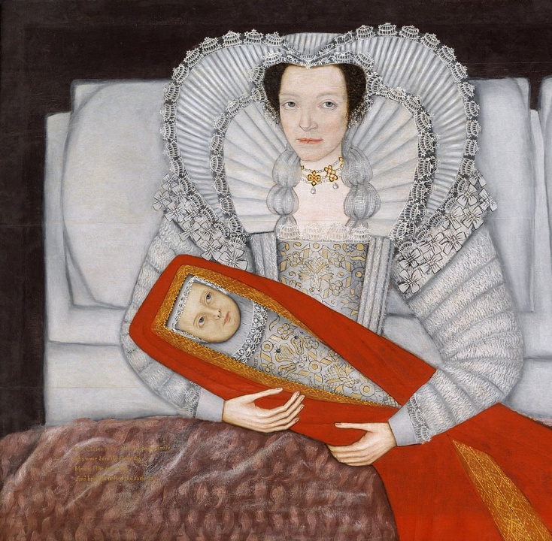
Original Sin

Slide 11
Original Innocence
(1800s– 1850s)

Slide 12
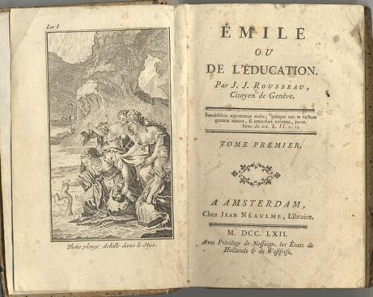
Original Innocence

Slide 13
Original Innocence
“But trailing clouds of glory do we come
From God, who is our home:
Heaven lies about us in our infancy!
Shades of the prison-house begin to close
Upon the growing Boy,
But he beholds the light, and whence it flows,
He sees it in his joy;
The Youth, who daily farther from the east
Must travel, still is Nature’s priest,
And by the vision splendid
Is on his way attended;
At length the Man perceives it die away,
And fade into the light of common day.”
- William Wordsworth
Ode: Intimiations of Imortality

Slide 14
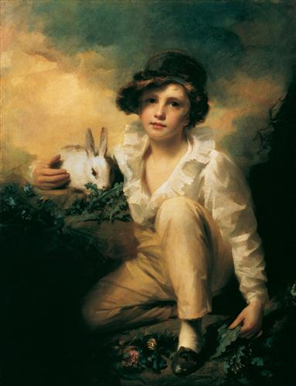
Original Innocence

Slide 15
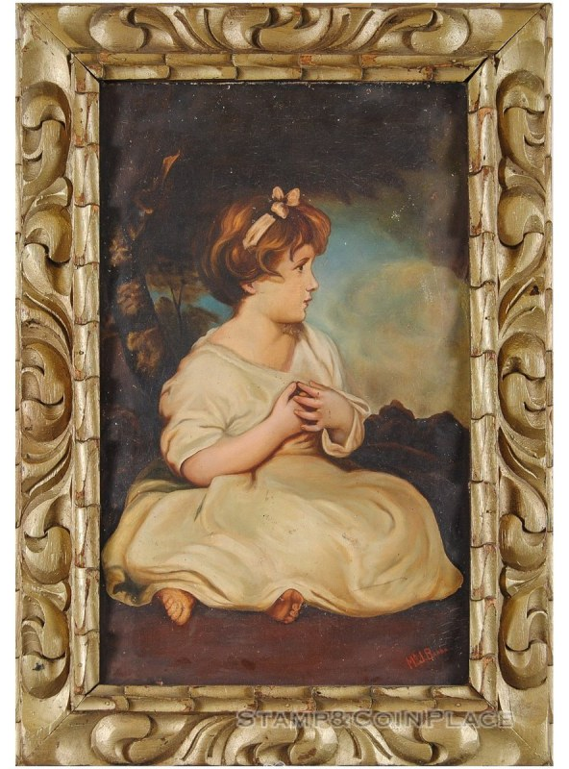
Original Sin vs. Innocence

Slide 16
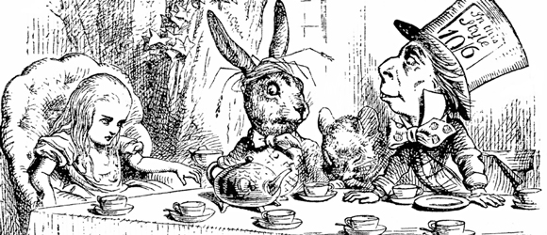
Alice in Wonderland (1865)

Slide 17
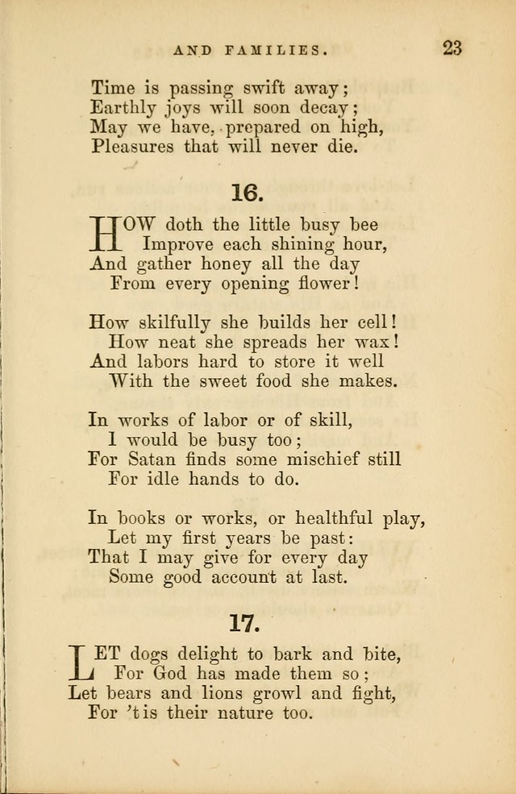
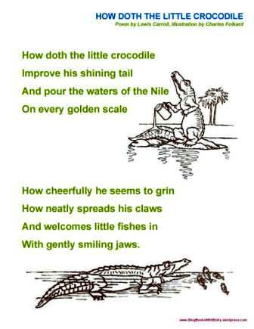
Alice - Poems

Slide 18
Cult of the Child
(1850s – 1900s)

Slide 19
Cult of the Child
"there is no more distinctive feature of the age than the enormous importance which children have assumed”
- Ernest Dowson
"to forget to act as reasonable men and women, nor suffer their fondness for their children to degenerate into a blind and stupid babyolatry“
- Chambers’ Edinburgh Journal

Slide 20
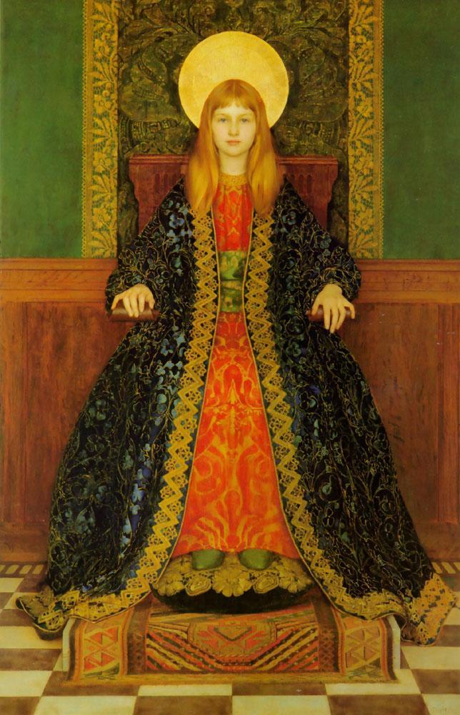
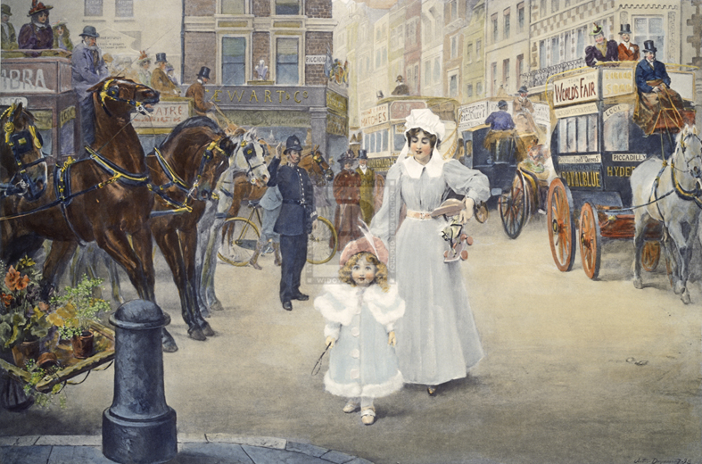
Cult of the Child

Slide 21
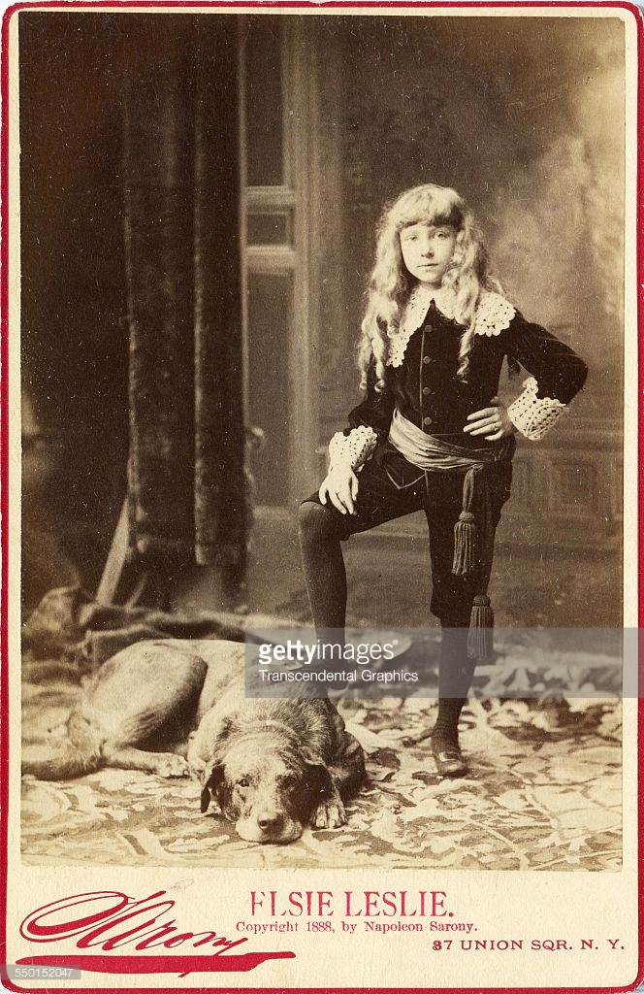
Innocence vs. Cult

Slide 22
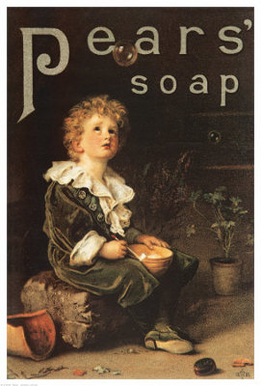
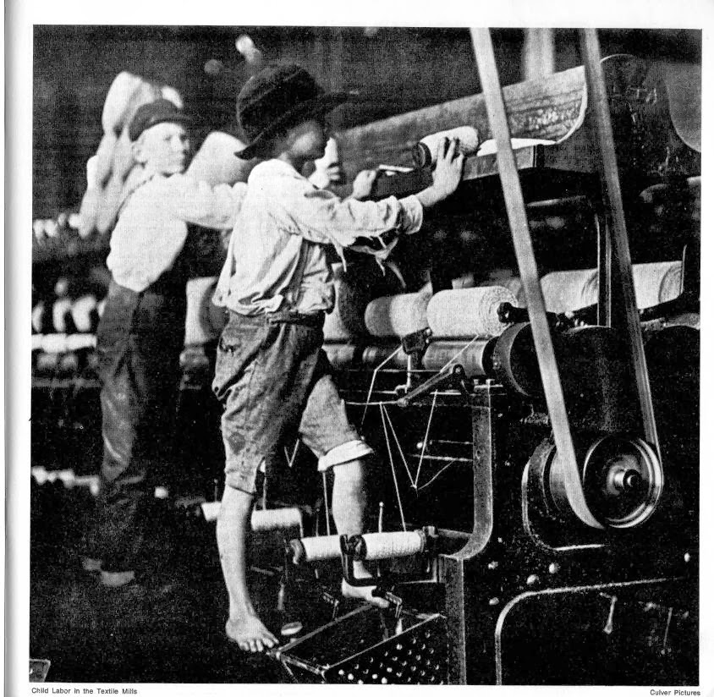
Cult of the Child - Contradictions

Slide 23
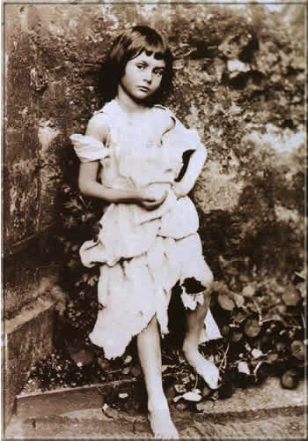
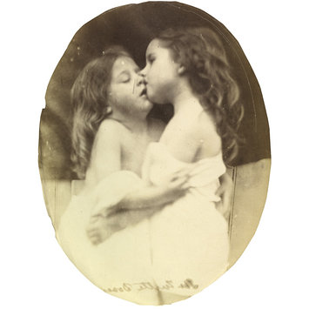
Cult of the Child - Contradictions

Slide 24
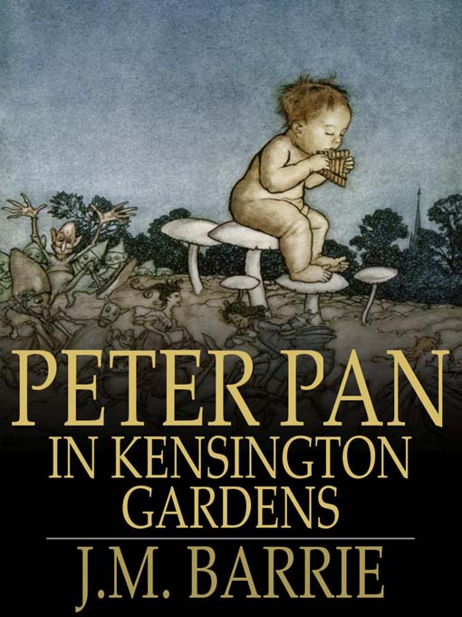
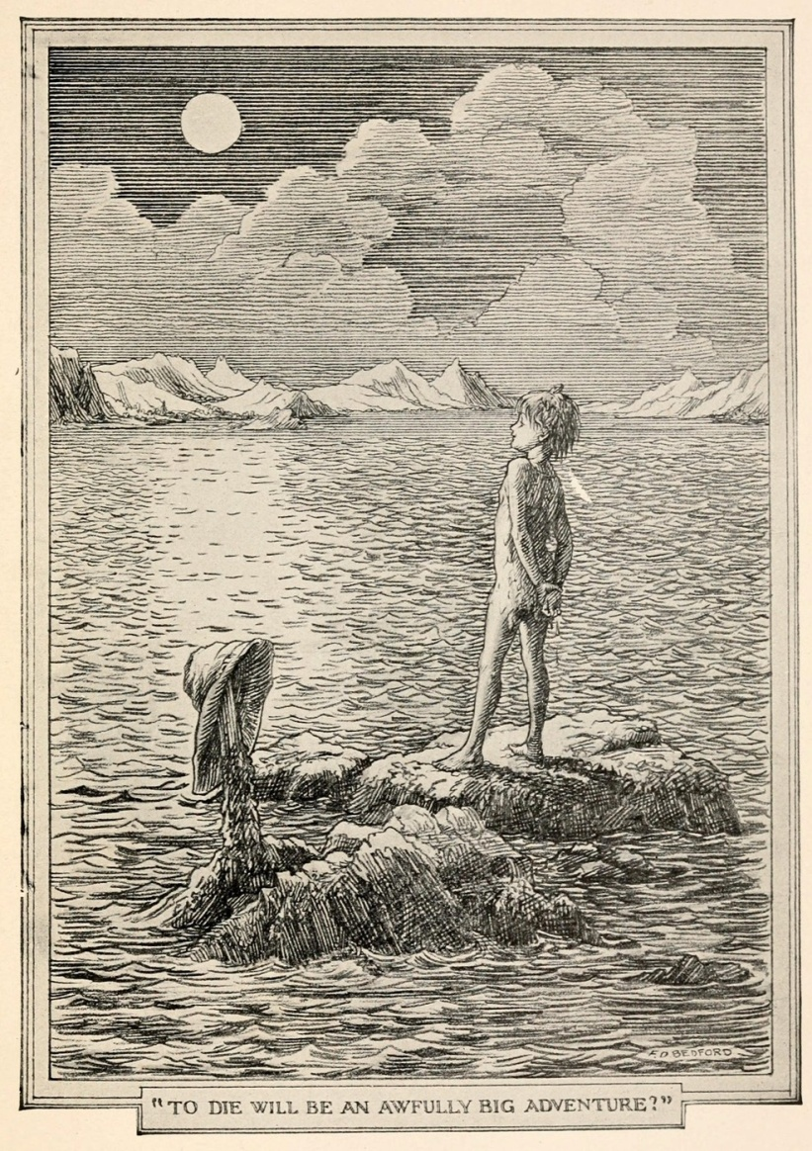
Peter Pan (1902 – 1911)

Slide 25
Exploitation of Cute
(1930s? – 1970s?)

Slide 26
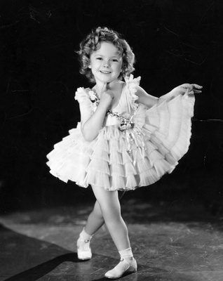
Exploitation of Cute

Slide 27
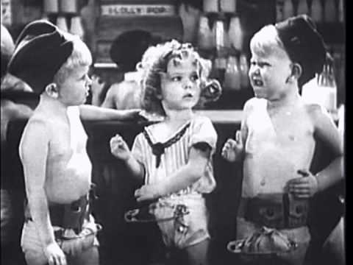
Exploitation of Cute
https://www.youtube.com/watch?v=ZsCQ0t-3t1I

Slide 28
Exploitation of Cute
“[‘War Babies’] was a cynical exploitation of our childish innocence”
- Shirley Temple
“Because the oppression of women and children is couched in the phraseology of “cute”, it is much harder to fight than open oppression”
- Shulamith Firestone

Slide 29
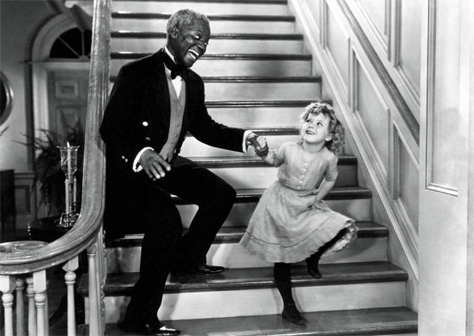
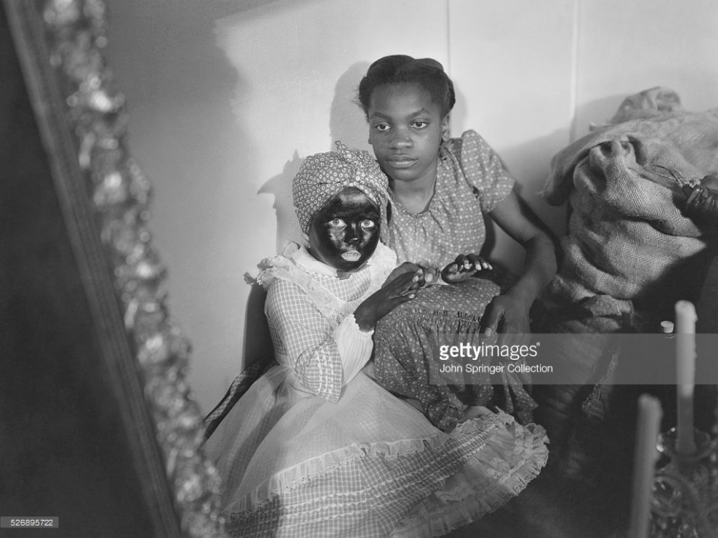
Exploitation of Cute
https://www.youtube.com/watch?v=776oLm9GXxQ

Slide 30
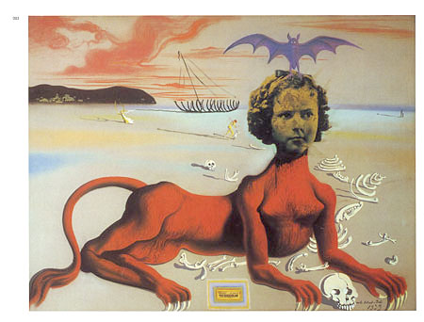
“Shirley Temple, The Youngest, Most Sacred Monster of the Cinema in Her Time”

Slide 31
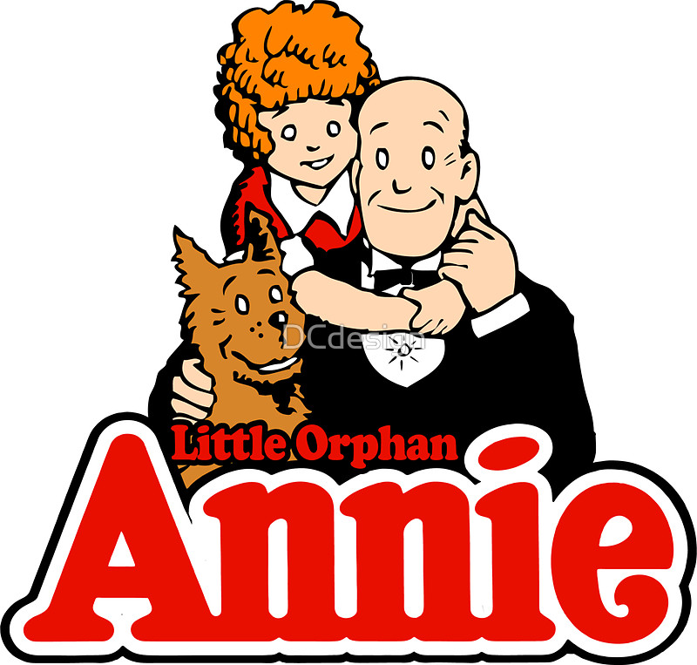
Little Orphan Annie

Slide 32
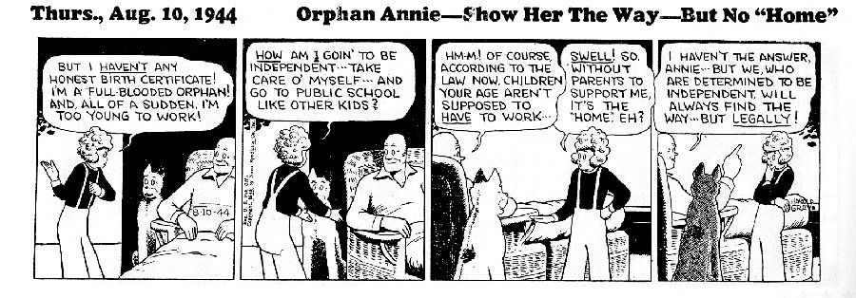
Little Orphan Annie

Slide 33
Modern Day?
(1970s - now)

Slide 34
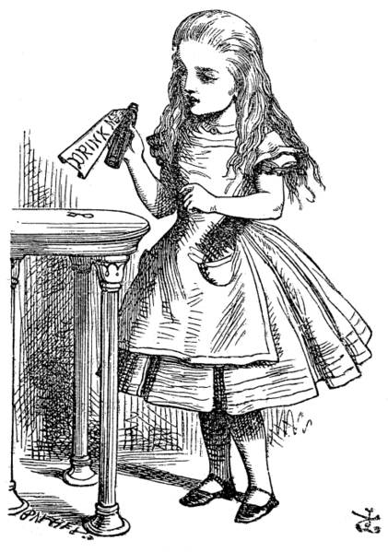
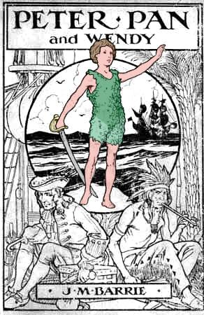
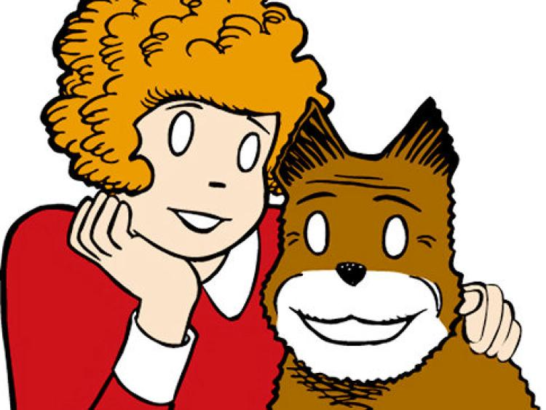
Adaptations

Slide 35
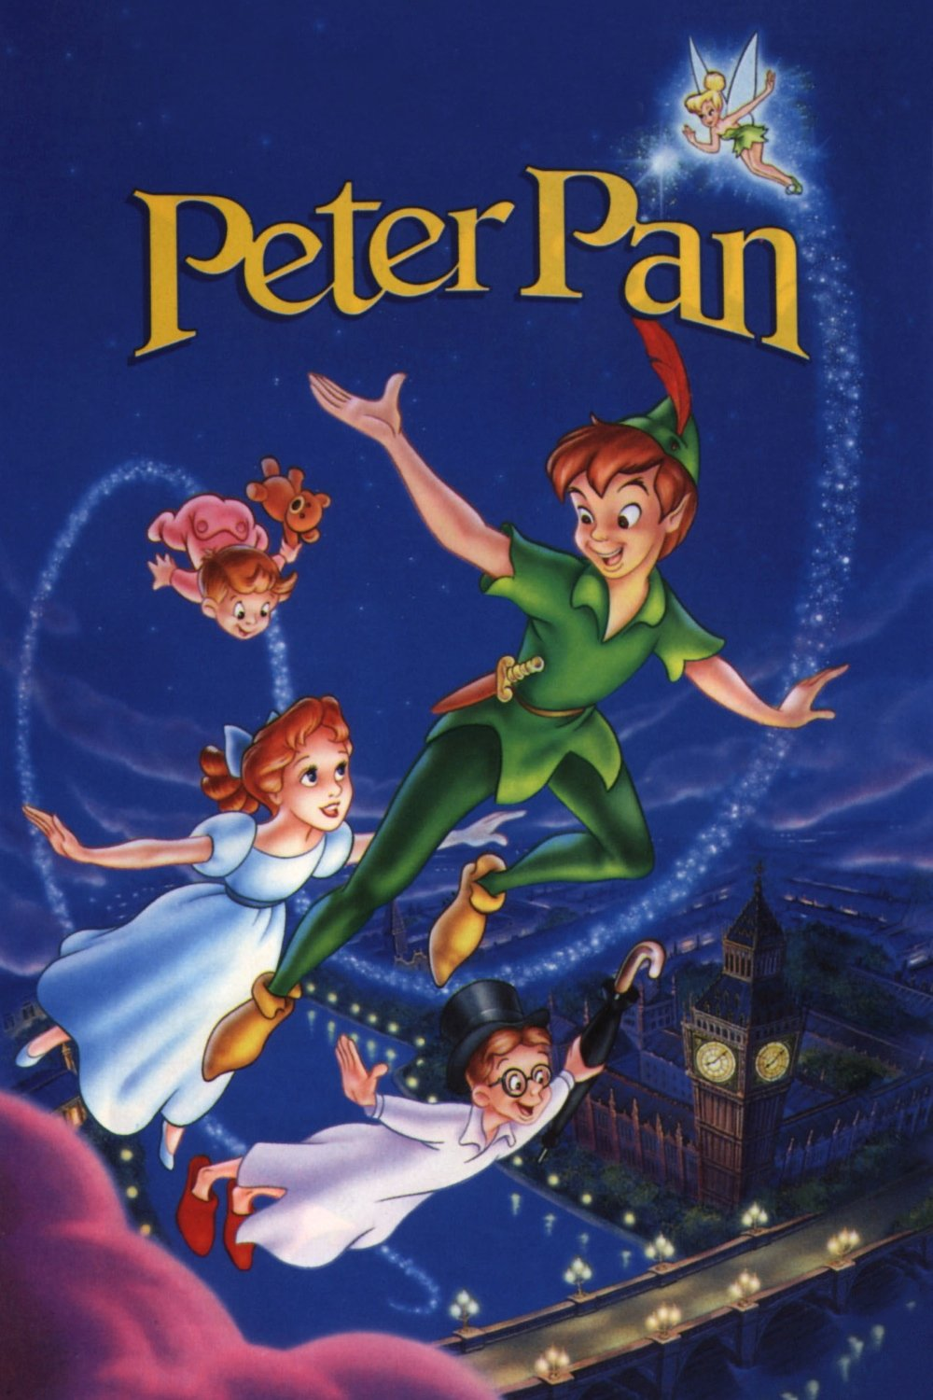
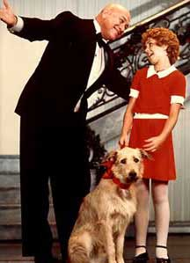
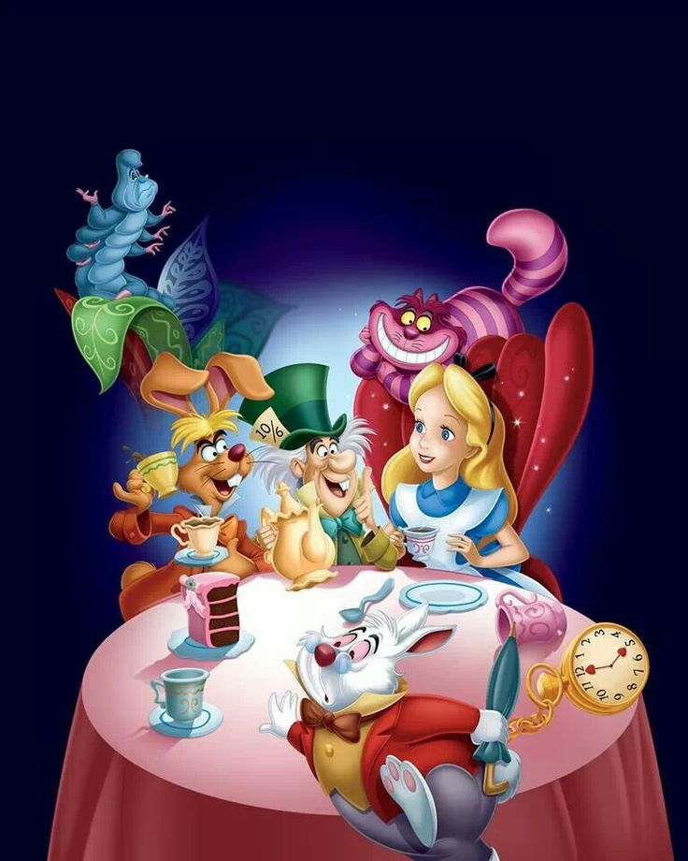
Adaptations

Slide 36
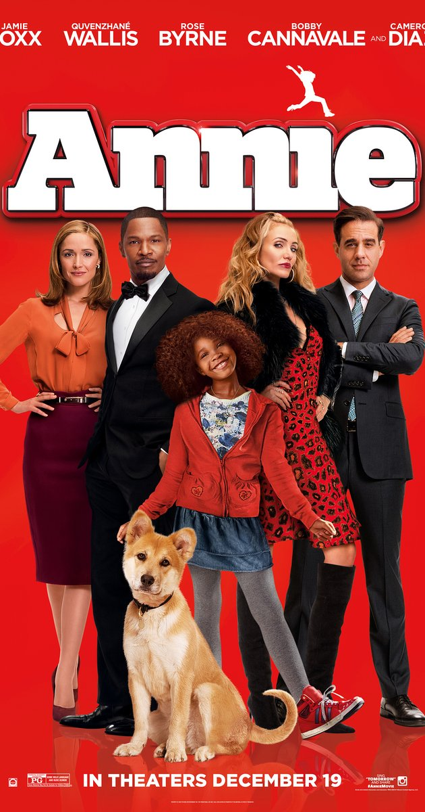
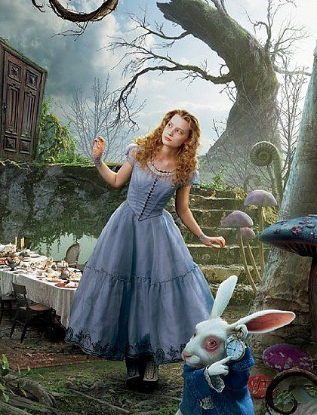
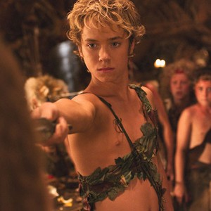
Adaptations

Slide 37
How do the modern adaptations change / reflect our understanding of childhood?
How do the Disney versions differ from the original source material?

Slide 38
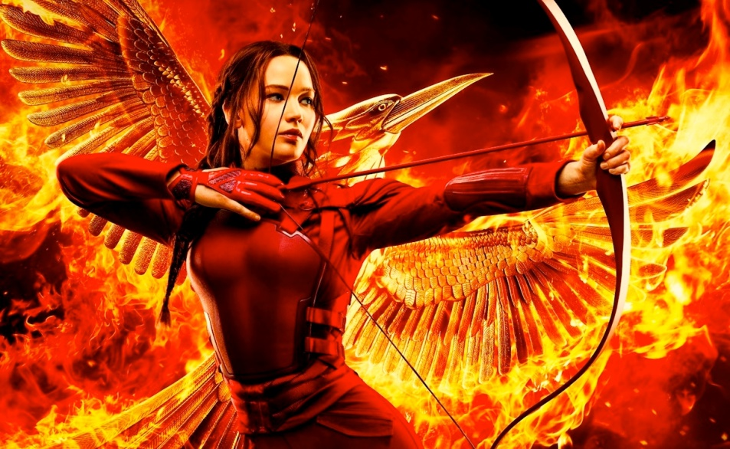
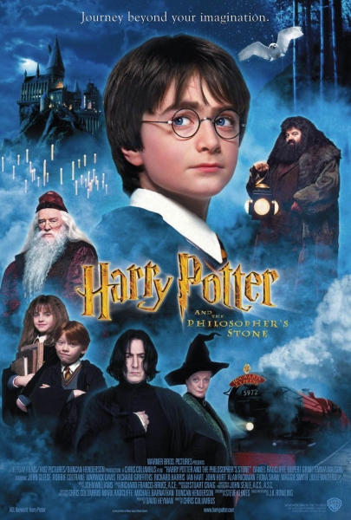
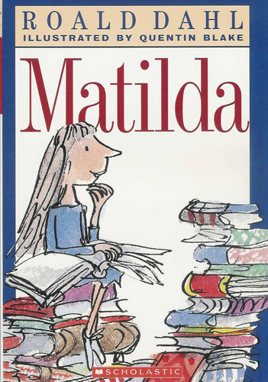
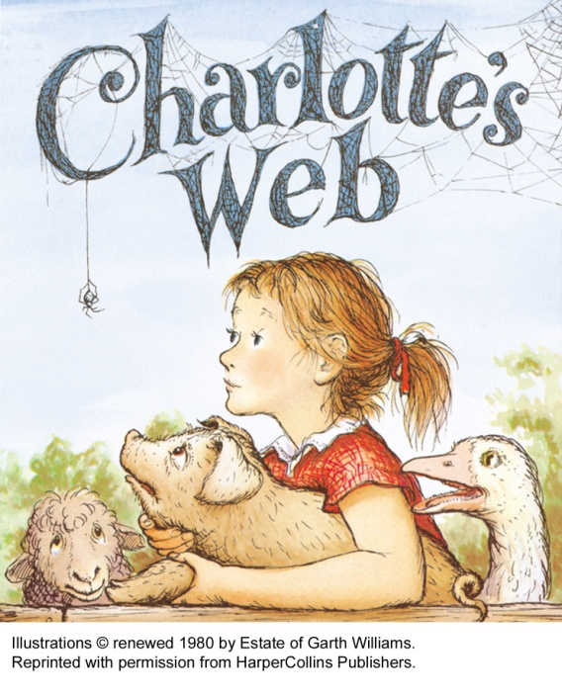
Modern Day

Slide 39
What do new children’s literature have to tell us about childhood now?

